Slide 1
Section 0.5
“Before Calculus”: Exponential and Logarithmic Functions

Slide 2
All graphics are attributed to:
Calculus,10/E by Howard Anton, Irl Bivens, and Stephen Davis
Copyright © 2009 by John Wiley & Sons, Inc. All rights reserved.

Slide 3
Remember from last year?
Rewrite logarithms with different bases.
Use properties of logarithms to evaluate or rewrite logarithmic expressions.
Use properties of logarithms to expand or condense logarithmic expressions.
Use logarithmic functions to model and solve real-life problems.

Slide 4
Change of Base
Most calculators have only two types of log keys, one for common logarithms (base 10) and one for natural logarithms (base e).
Although common logs and natural logs are the most frequently used, you may occasionally need to evaluate logarithms to other bases. To do this, you can use the following change-of-base formula.

Slide 5
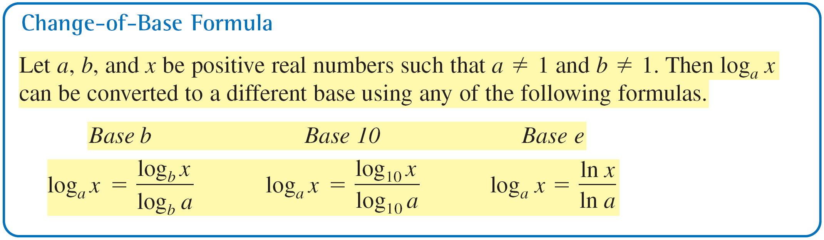
Change of Base

Slide 6
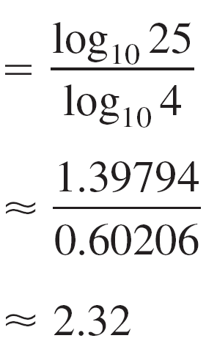
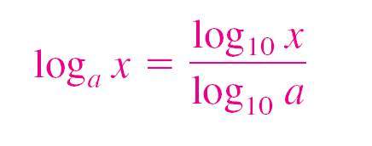
Example 1 – Changing Bases Using Common Logarithms
Log₄25
≈ 2.23
b. Log₂12
≈ 3.58
Use a Calculator.
Simplify.

Slide 7
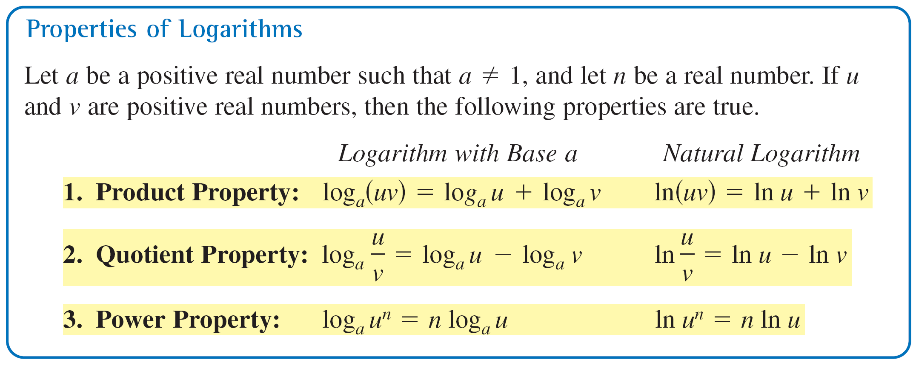
Properties of Logarithms

Slide 8
Example 3 – Using Properties of Logarithms
Write each logarithm in terms of ln 2 and ln 3.
a. ln 6 b. ln
Solution:
a. ln 6 = ln(2  3)
= ln 2 + ln 3
b. ln = ln 2 – ln 27
= ln 2 – ln 3³
= ln 2 – 3 ln 3
Rewrite 6 as 2  3.
Product Property
Quotient Property
Rewrite 27 as 3³
Power Property

Slide 9
Rewriting Logarithmic Expressions
The properties of logarithms are useful for rewriting logarithmic expressions in forms that simplify the operations of algebra. This is true because they convert complicated products, quotients, and exponential forms into simpler sums, differences, and products, respectively.

Slide 10
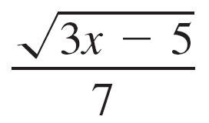
Example 5 – Expanding Logarithmic Expressions
Use the properties of logarithms to expand each expression.
a. log₄5x³y
b. ln
Solution:
a. log₄5x³y = log₄5 + log₄x³ + log₄ y
= log₄5 + 3 log₄x + log₄y
Product Property
Power Property

Slide 11
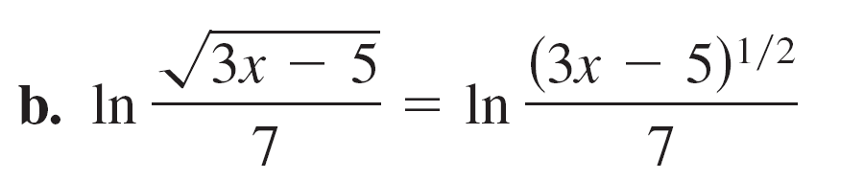
Example 5 – Solution
cont’d
Rewrite radical using
rational exponent.
Quotient Property
Power Property

Slide 12
Rewriting Logarithmic Expressions
In Example 5, the properties of logarithms were used to expand logarithmic expressions.
In Example 6, this procedure is reversed and the properties of logarithms are used to condense logarithmic expressions.

Slide 13

Example 6 – Condensing Logarithmic Expressions
Use the properties of logarithms to condense each expression.
a. log₁₀x + 3 log₁₀(x + 1)
b. 2ln(x + 2) – lnx
c. [log₂x + log₂(x – 4)]

Slide 14
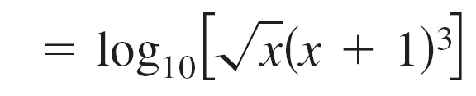
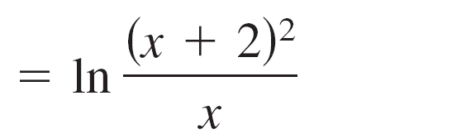
Example 6 – Solution
Power Property
Product Property
Power Property
Quotient Property
a. log₁₀x + 3 log₁₀(x + 1)
=log₁₀x^{1/2} + log₁₀(x + 1)³
b. 2 ln(x + 2) – ln x
= ln(x + 2)² – ln x

Slide 15
Example 6 – Solution
cont’d
c. [log₂x + log₂(x – 4)]
= log₂[x (x – 4)]
= log₂[x(x – 4)]^{1/3}
Product Property
Power Property
Rewrite with a radical.

Slide 16
Also from last year…
Solve simple exponential and logarithmic equations.
Solve more complicated exponential equations.
Solve more complicated logarithmic equations.
Use exponential and logarithmic equations to model and solve real-life problems.

Slide 17
Helpful Properties
One-to-One Properties
a^{x} = a^{y} if and only if x = y.
log_{a} x = log_{a} y if and only if x = y.
Inverse Properties
a^{loga x} = x
log_{a} a^{x} = x

Slide 18
Example 1 – Solving Simple Exponential and Logarithmic Exponential

Slide 19
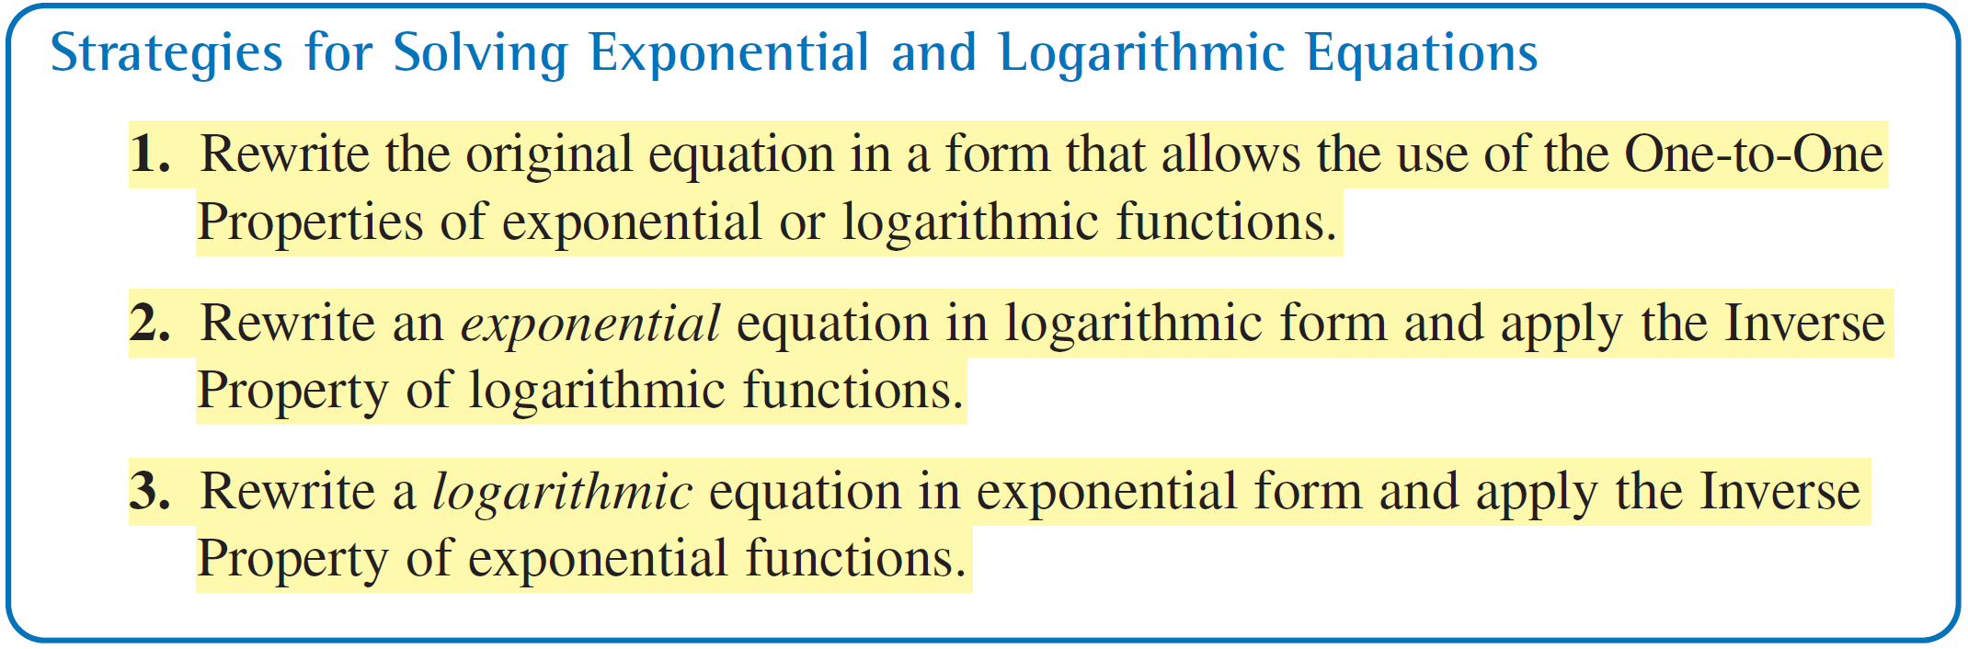
Strategies:

Slide 20
Solving Logarithmic Equations
To solve a logarithmic equation, you can write it in exponential form. Many of you liked the “swoop” method.
ln x = 3
x = e³
This procedure is applied after the logarithmic expression has
been isolated.

Slide 21
Example 6 – Solving Logarithmic Equations
Solve each logarithmic equation.
a. ln 3x = 2
b. log₃(5x – 1) = log₃(x + 7)
.

Slide 22

Example 6 – Solution
cont’d
Solution:
a. ln 3x = 2
3x = e²
The solution is
x ≈ 2.46
Check this in the original equation.

Slide 23
Example 6 – Solution
cont’d
b. log₃(5x – 1) = log₃(x + 7)
5x – 1 = x + 7
x = 2
The solution x = 2. Check this in the original equation.
Write original equation.
One-to-One Property
Solve for x

Slide 24
Solving Logarithmic Equations
Because the domain of a logarithmic function generally does not include all real numbers, you should be sure to check for extraneous solutions of logarithmic equations.

Slide 25
pH Value
In case you forget to read directions sometimes, like I do ☺, the formula for pH value is on pg 62.
pH = -log [H+]
(where [H+] denotes the concentrations of hydrogen ions measured in moles per liter.)

